Slide 1
Sales Performance & Profitability Analysis
Data Storytelling & Statistical Validation
Jagan Mohan Reddy B

Slide 2
Business Objective
Understand sales performance and profitability drivers
Identify high-performing regions and product categories
Analyze how discounts affect profits
Generate actionable recommendations for business growth

Slide 3
Dataset Overview
Dataset: Global Store Sales
Total Records: ~51K
Key Fields: Sales, Profit, Discount, Category, Segment, Region
Tools Used: Python, Pandas, Data Visualization, Statistical Testing

Slide 4
Key Performance Indicators
Total Sales Revenue
Total Profit Generated
Average Discount Applied
Average Order Value
Total Orders Processed

Slide 5
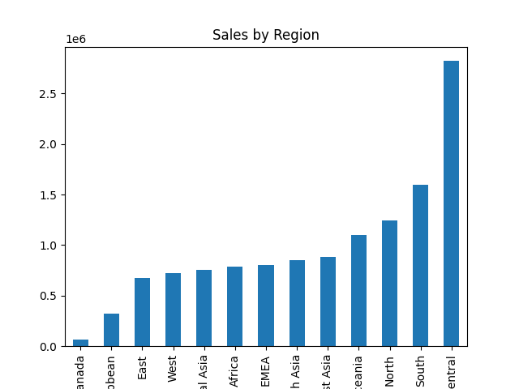
Regional Sales Analysis
Key Insight
West and East regions contribute the highest revenue. Some regions show high sales but lower profit margins.

Slide 6
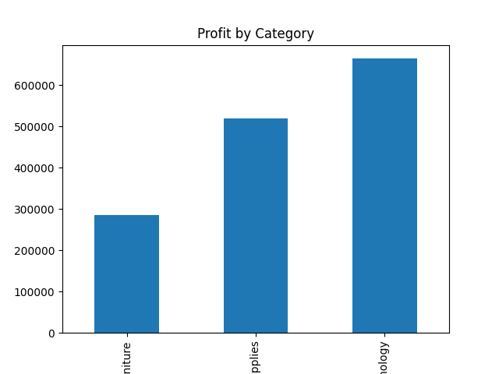
Category Profitability
Key Insight
Technology category generates the highest profit while some categories depend heavily on discounting.

Slide 7
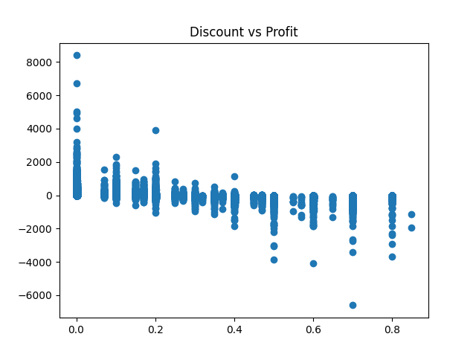
Discount vs Profit Relationship
Key Insight
High discounts correlate with lower profits. Discounts above 20% frequently lead to negative margins.

Slide 8
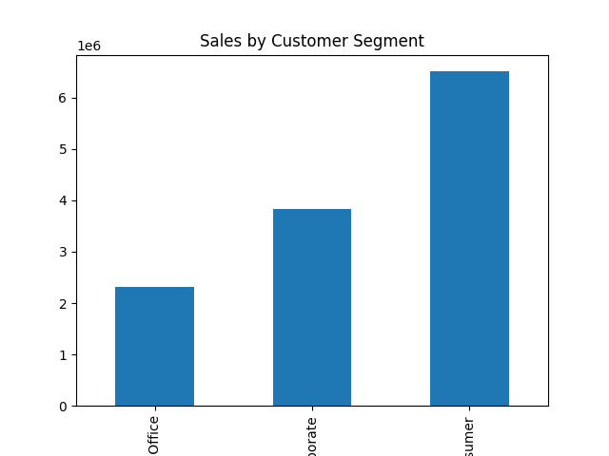
Customer Segment Insights
Key Insight
Corporate customers generate higher value orders while consumer segment drives order volume.

Slide 9
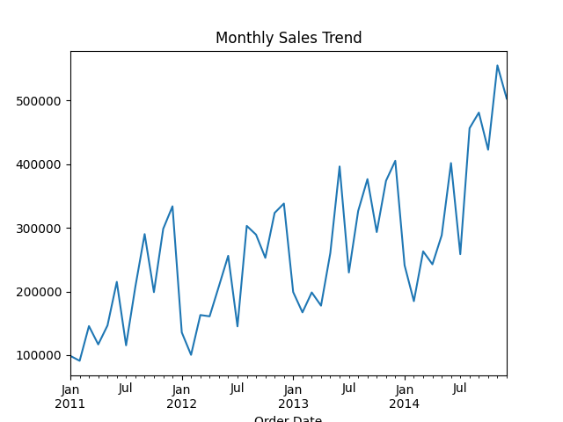
Sales Trend Over Time
Key Insight
Sales fluctuate over time with noticeable seasonal peaks suggesting demand cycles.

Slide 10
Strategic Business Recommendations
Limit excessive discounting to protect margins
Invest more in high-profit categories like Technology
Investigate operational inefficiencies in low-profit regions
Develop loyalty programs for high-value corporate customers

